Slide 1
Hierarchical clustering Algorithm
Hierarchical clustering algorithm is of two types:
i) Agglomerative Hierarchical clustering algorithm or AGNES (agglomerative nesting) (Bottom up Approach)
ii) Divisive Hierarchical clustering algorithm or DIANA (divisive analysis) (Top down Approach)
http://people.revoledu.com/kardi/tutorial/Clustering/resources.htm#ClusteringTutorial
http://www2.cs.uregina.ca/~dbd/cs831/notes/clustering/clustering.html
Notes:
Compare degrees of memberships in k-means and fuzzy c-means

Slide 2
Hierarchical clustering Algorithm
Agglomerative Hierarchical clustering -This algorithm works by grouping the data one by one on the basis of the nearest distance measure of all the pairwise distance between the data point.
Again distance between the data point is recalculated but which distance to consider when the groups has been formed? For this there are many available methods. Some of them are:
1) single-nearest distance or single linkage.
2) complete-farthest distance or complete linkage.
3) average-average distance or average linkage.
4) centroid distance.
5) ward's method - sum of squared euclidean distance is minimized.

Slide 3
Hierarchical clustering Algorithm
Let X = {x₁, x₂, x₃, ..., x_{n}} be the set of data points.
Begin with the disjoint clustering having level L(0) = 0 and sequence number m = 0.
Find the least distance pair of clusters in the current clustering, say pair (r), (s), according to d[(r),(s)] = min d[(i),(j)] where the minimum is over all pairs of clusters in the current clustering.
Increment the sequence number: m = m +1.Merge clusters (r) and (s) into a single cluster to form the next clustering m. Set the level of this clustering to L(m) = d[(r),(s)].
Update the distance matrix, D, by deleting the rows and columns corresponding to clusters (r) and (s) and adding a row and column corresponding to the newly formed cluster. The distance between the new cluster, denoted (r,s) and old cluster(k) is defined in this way: d[(k), (r,s)] = min (d[(k),(r)], d[(k),(s)]).
If all the data points are in one cluster then stop, else repeat from step 2).
Divisive Hierarchical clustering - It is just the reverse of Agglomerative
Hierarchical approach.

Slide 4
Agglomerative Hierarchical Algorithm:
Given:
A set X of objects {x₁,...,x_{n}}
A distance function dis(c₁,c₂)
for i = 1 to n c_{i} = {x_{i}}
end for
C = {c₁,...,c_{b}}
l = n+1
while C.size > 1 do
a) (c_{min1},c_{min2}) = minimum dis(c_{i}, c_{j}) for all c_{i}, c_{j}in C
b) remove c_{min1} and c_{min2} from C
c) add {c_{min1},c_{min2}} to C
d) l = l + 1
end while

Slide 5
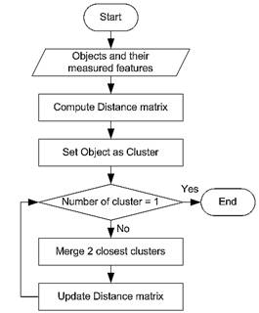

Agglomerative Hierarchical Algorithm:

Slide 6
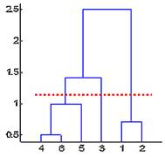


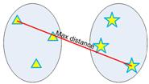

Hierarchical clustering Algorithm
In the context of hierarchical clustering, the hierarchy graph is called a dendogram
Single Linkage: Minimum distance criterion
Complete Linkage: Maximum distance criterion

Slide 7
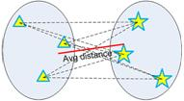



Hierarchical clustering Algorithm
Complete Linkage: Average distance criterion
Complete Linkage: Centriod distance criterion

Slide 8

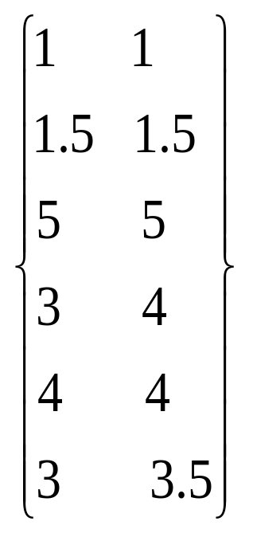
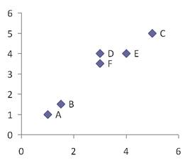
Let us consider the 6 objects (with name A,B,C, D, E and F) and each object have two measured features (X1, X2)

Slide 9
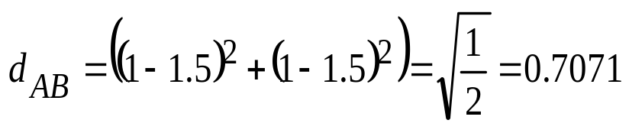
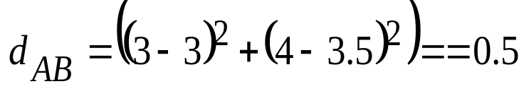
For example distance between object A=(1,1) and B=(1.5,1.5) is computed as
Another Example of distance between object D=(3,4) and F=(3, 3.5) is
Using the same above notation we can compute all distances between objects and put the distance into matrix form. Since distance is symmetric (i:e dist between A and B is = B and A)
Dist
A | B | C | D | E | F
A
B
C
D
E
F
0.00 | 0.71 | 5.66 | 3.61 | 4.24 | 3.20
0.71 | 0.00 | 4.95 | 2.92 | 3.54 | 2.50
5.66 | 4.95 | 0.00 | 2.94 | 1.41 | 2.50
3.61 | 2.92 | 2.24 | 0.00 | 1.00 | 0.50
4.24 | 3.54 | 1.41 | 1.00 | 0.00 | 1.12
3.20 | 2.50 | 2.50 | 0.50 | 1.12 | 0.00

Slide 10
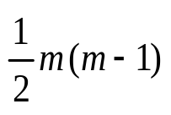
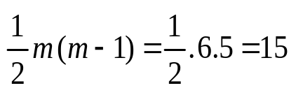
Hierarchical clustering Algorithm
In general we have m objects, the number of distances on the lower triangular contain nor of elements. Here, we have 6 objects here the total distance need to be computed is
If the objects contain not only numeric features, you can compute the distance using type of distances and aggregate.
Now compute the linkages
0.71 | 5.66 | 3.61 | 4.24 | 2.92 | 3.54 | 2.5 | 2.24 | 1.41 | 2.5 | 1 | 0.5 | 1.12

Slide 11
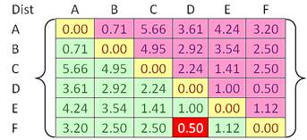
Hierarchical clustering Algorithm
The rule of Hierarchical clustering lie on how objects should be grouped into clusters. Given a distance matrix, linkages between the objects can be computed through a criterion to compute the distance between groups.
Now we have a input distance matrix of size 6 by 6. This distance matrix was calculated based on the object features by single linkage

Slide 12
Hierarchical clustering Algorithm
In the beginning we have 6 clusters. Our goal is to group those 6 clusters such that at the end of the iterations, we will have only single cluster consists of the whole six original objects
Now find the closest pair cluster. Here We have shortest distance 0.5 with F and D thus we group cluster D and F into cluster
(D,F) then we update the distance Matrix

Slide 13
Hierarchical clustering Algorithm
By Using Single linkage rule we calculate minimum distance between original objects of the two clusters
Using the input distance matrix, distance between (D, F) and cluster A is computed
A | B | C | D F | E
A
B
C
D F
E
0.00 | 0.71 | 5.66 | ? | 4.24
0.71 | 0.00 | 4.95 | ? | 3.54
5.66 | 4.95 | 0.00 | ? | 1.41
? | ? | ? | 0.00 | 1.00
4.24 | 3.54 | 1.41 | 1.00 | 0.00

Slide 14
Hierarchical clustering Algorithm
Distance between Cluster (D,F) and B
Updating the distance with DF to C and E also
Now we have minimum distance from Cluster B and A
A | B | C | D F | E
A
B
C
D F
E
0.00 | 0.71 | 5.66 | 3.20 | 4.24
0.71 | 0.00 | 4.95 | 2.50 | 3.54
5.66 | 4.95 | 0.00 | 2.24 | 1.41
3.20 | 2.50 | 2.24 | 0.00 | 1.00
4.24 | 3.54 | 1.41 | 1.00 | 0.00

Slide 15
Hierarchical clustering Algorithm
Now we group Cluster B and A with Cluster name(A,B).
Using Input distance Matrix, (size (6x6)) distance between Cluster C and DF
A,B | C | (D,F) | E
(A,B)
C
(D,F)
E
0.00 | ? | ? | ?
? | 0.00 | 2.24 | 1.41
? | 2.24 | 0.00 | 1.00
? | 1.41 | 1.00 | 0.00

Slide 16
Hierarchical clustering Algorithm
Distance between Cluster DF and AB
Similarly for E and (A,B)
A,B | C | (D,F) | E
(A,B)
C
(D,F)
E
0.00 | 4.95 | 2.50 | 3.54
4.95 | 0.00 | 2.24 | 1.41
2.50 | 2.24 | 0.00 | 1.00
3.54 | 1.41 | 1.00 | 0.00

Slide 17
Hierarchical clustering Algorithm
Now the closest Distance between cluster E and (DF), we cluster them into ((D,F), E)
After Updating the Distance Matrix
A,B | C | (D,F),E)
A,B | C | (D,F),E)
(A,B)
C
(D,F),E
0.00 | 4.95 | 2.50
4.95 | 0.00 | 1.41
2.50 | 1.41 | 0.00
(A,B)
C
(D,F),E
0.00 | 4.95 | 2.50
4.95 | 0.00 | 1.41
2.50 | 1.41 | 0.00

Slide 18
Hierarchical clustering Algorithm
After Updating the Distance Matrix
A,B | ((D,F),E),C)
(A,B)
((D,F),E), C)
0.00 | 2.50
2.50 | 0.00

Slide 19
Hierarchical clustering Algorithm
In the beginning we have 6 Clusters
We first merge clusters D and F into cluster (D,F) at distance 0.50.
We first merge clusters A and Cluster B into (A,B) at distance 0.71
We first merge clusters E and (D,F) into cluster ((D,F),E) at distance 1.00
We first merge clusters ((D,F),E) and C into cluster (((D,F),E),C), at distance 1.41.
We first merge clusters (((D,F),E),C) and (A,B) into cluster ((((D,F),E),C), (A,B)) at distance 2.50.
The last cluster contain all the objects.

Slide 20
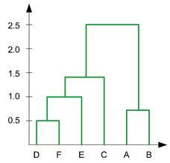
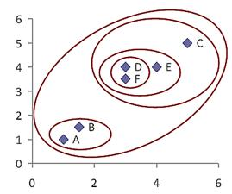
Final Result of a dendogram

Slide 21
Example: Agglomerative Hierarchical Clustering
Clustering starts by computing a distance between every pair of units that you want to cluster. A distance matrix will be symmetric (because the distance between x and y is the same as the distance between y and x) and will have zeroes on the diagonal (because every item is distance zero from itself).
The table below is an example of a distance matrix. Only the lower triangle is shown, because the upper triangle can be filled in by reflection.

Slide 22
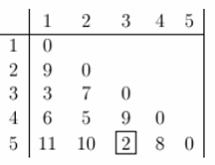
Complete Linkage Clustering
Now lets start clustering. The smallest distance is between three and five and they get linked up or merged first into a the cluster '35'.
To obtain the new distance matrix, we need to remove the 3 and 5 entries, and replace it by an entry "35" . Since we are using complete linkage clustering, the distance between "35" and every other item is the maximum of the distance between this item and 3 and this item and 5. For example, d(1,3)= 3 and d(1,5)=11. So, D(1,"35")=11. This gives us the new distance matrix. The items with the smallest distance get clustered next. This will be 2 and 4.

Slide 23
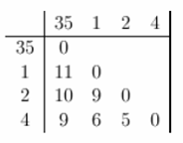
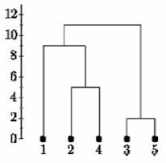
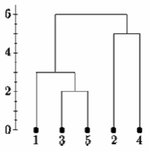
Complete Linkage Clustering
Continuing in this way, after 6 steps, everything is clustered. This is summarized below. On this plot, the y-axis shows the distance between the objects at the time they were clustered. This is called the cluster height. Different visualizations use different measures of cluster height
Complete Linkage
Single Linkage

